Slide 1




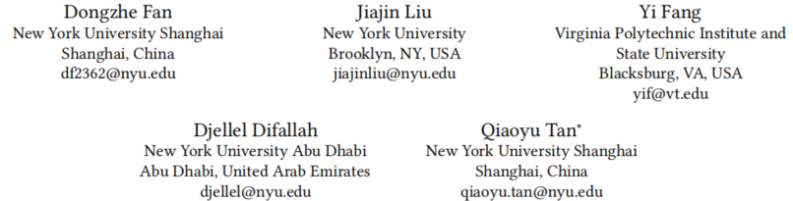





ATAI
Advanced Technique of Artificial Intelligence
ATAI
ChongqingUniversity _{AdvancedTechniqueof}
of Technology Artificial Intelligence
Chongqing University of
Technology
Chongqing University ^{ATAI}
_{of Technology} Advanced Techniqueof
Artificial Intelligence
Chongqing University of Technology
Chongqing University of Technology
MLaGA: Multimodal Large Language and Graph Assistant
Code : https://doi.org/10.5281/zenodo.20493431
——KDD_2026
Reported by Mingyu Yang
1

Slide 2
ATAI
Advanced Technique of Artificial Intelligence
ATAI
ChongqingUniversity _{AdvancedTechniqueof}
of Technology Artificial Intelligence
Chongqing University of
Technology
Chongqing University ^{ATAI}
_{of Technology} Advanced Techniqueof
Artificial Intelligence
Chongqing University of Technology
Chongqing University of Technology
Motivation
Effectively modeling MMGs presents two key challenges:
(i) capturing fine-grained cross-modal interactions—e.g., between visual
patches and word tokens—while preserving structural dependencies.
(ii) achieving unified generalization across diverse tasks and domains within a single model.
Notes:
同质图：节点都是一种类型，例如“用户”。边也是一种类型， “交互”。U-I图其实就是异构图

Slide 3
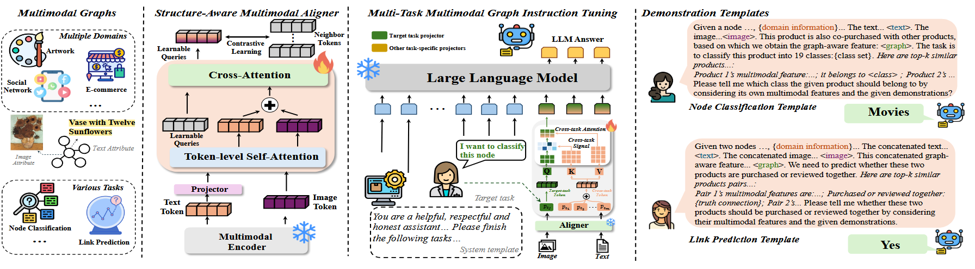
ATAI
Advanced Technique of Artificial Intelligence
ATAI
ChongqingUniversity _{AdvancedTechniqueof}
of Technology Artificial Intelligence
Chongqing University of
Technology
Chongqing University ^{ATAI}
_{of Technology} Advanced Techniqueof
Artificial Intelligence
Chongqing University of Technology
Chongqing University of Technology
Method

Slide 4






ATAI
Advanced Technique of Artificial Intelligence
ATAI
ChongqingUniversity _{AdvancedTechniqueof}
of Technology Artificial Intelligence
Chongqing University of
Technology
Chongqing University ^{ATAI}
_{of Technology} Advanced Techniqueof
Artificial Intelligence
Chongqing University of Technology
Chongqing University of Technology
Method

Slide 5

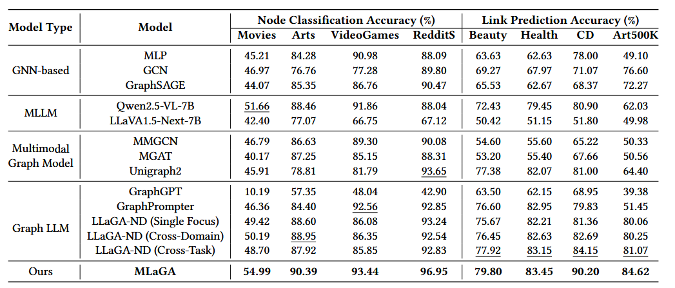
ATAI
Advanced Technique of Artificial Intelligence
ATAI
ChongqingUniversity _{AdvancedTechniqueof}
of Technology Artificial Intelligence
Chongqing University of
Technology
Chongqing University ^{ATAI}
_{of Technology} Advanced Techniqueof
Artificial Intelligence
Chongqing University of Technology
Chongqing University of Technology

Slide 6
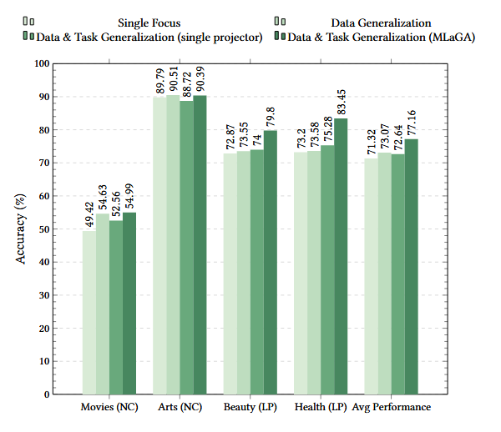
ATAI
Advanced Technique of Artificial Intelligence
ATAI
ChongqingUniversity _{AdvancedTechniqueof}
of Technology Artificial Intelligence
Chongqing University of
Technology
Chongqing University ^{ATAI}
_{of Technology} Advanced Techniqueof
Artificial Intelligence
Chongqing University of Technology
Chongqing University of Technology

Slide 7
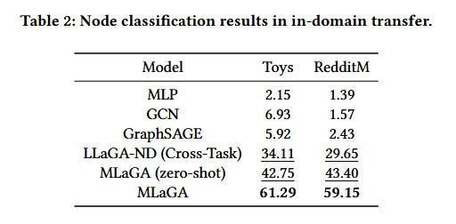
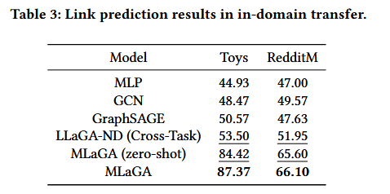
ATAI
Advanced Technique of Artificial Intelligence
ATAI
ChongqingUniversity _{AdvancedTechniqueof}
of Technology Artificial Intelligence
Chongqing University of
Technology
Chongqing University ^{ATAI}
_{of Technology} Advanced Techniqueof
Artificial Intelligence
Chongqing University of Technology
Chongqing University of Technology

Slide 8
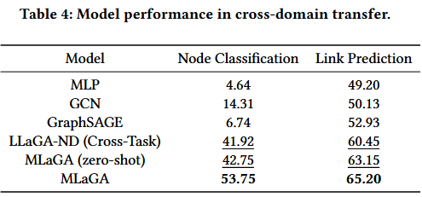
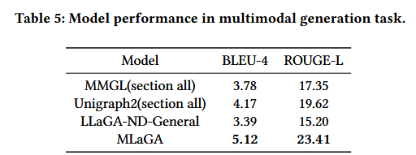
ATAI
Advanced Technique of Artificial Intelligence
ATAI
ChongqingUniversity _{AdvancedTechniqueof}
of Technology Artificial Intelligence
Chongqing University of
Technology
Chongqing University ^{ATAI}
_{of Technology} Advanced Techniqueof
Artificial Intelligence
Chongqing University of Technology
Chongqing University of Technology
Notes:
第三个实验，可以发现当越晚后面会出现信息比较少，使用其他的模态信息补齐可以缓解

Slide 9
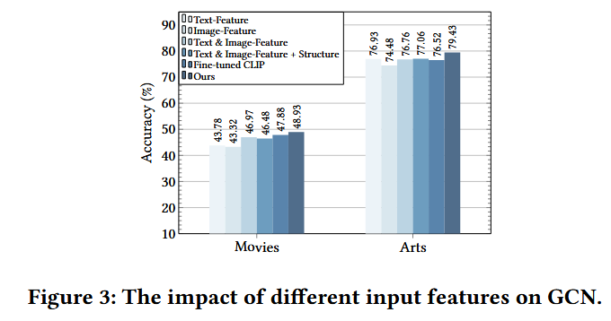
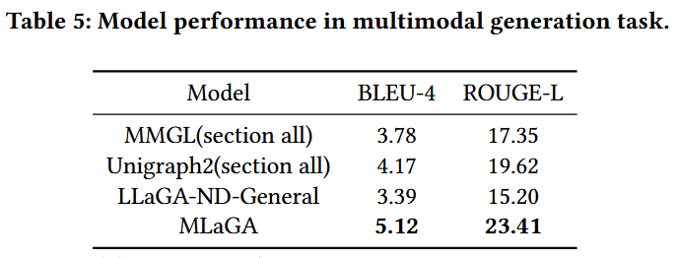
ATAI
Advanced Technique of Artificial Intelligence
ATAI
ChongqingUniversity _{AdvancedTechniqueof}
of Technology Artificial Intelligence
Chongqing University of
Technology
Chongqing University ^{ATAI}
_{of Technology} Advanced Techniqueof
Artificial Intelligence
Chongqing University of Technology
Chongqing University of Technology

Slide 10
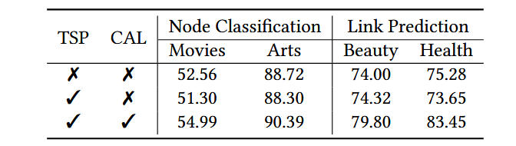
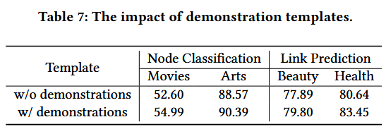
ATAI
Advanced Technique of Artificial Intelligence
ATAI
ChongqingUniversity _{AdvancedTechniqueof}
of Technology Artificial Intelligence
Chongqing University of
Technology
Chongqing University ^{ATAI}
_{of Technology} Advanced Techniqueof
Artificial Intelligence
Chongqing University of Technology
Chongqing University of Technology

Slide 11


ATAI
Advanced Technique of Artificial Intelligence
ATAI
ChongqingUniversity _{AdvancedTechniqueof}
of Technology Artificial Intelligence
Chongqing University of
Technology
Chongqing University ^{ATAI}
_{of Technology} Advanced Techniqueof
Artificial Intelligence
Chongqing University of Technology
Chongqing University of Technology
Thanks!

